Slide 1
Digital Pulse Modulation

Slide 2
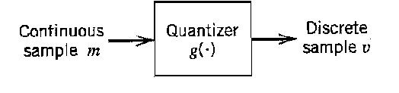
Quantization Process
Original Continuous signal]al is approximated by discrete set of
amplitudes which are chosen from available sets to give
minimum error.
Transform sampled signal m(nT_{s}) into discrete amplitudes v(nT_{s})
Quantization is memoryless and instantaneous and hence not affected
by earlier or later samples.
V =g(m)
g() is mapping function called quantizer characteristics, It can be
uniform/non-uniform staircase structure.

Slide 3
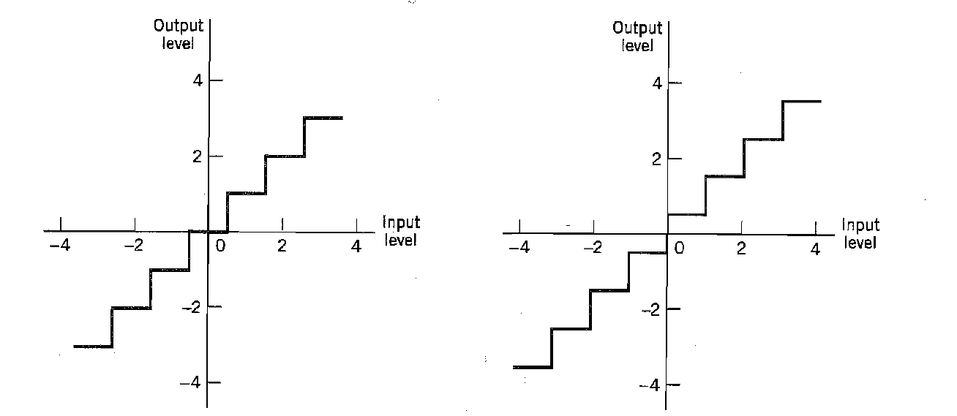
Midtread Midrise
Input levels-decision levels or decision thresholds
Output levels-representation/reconstruction levels

Slide 4
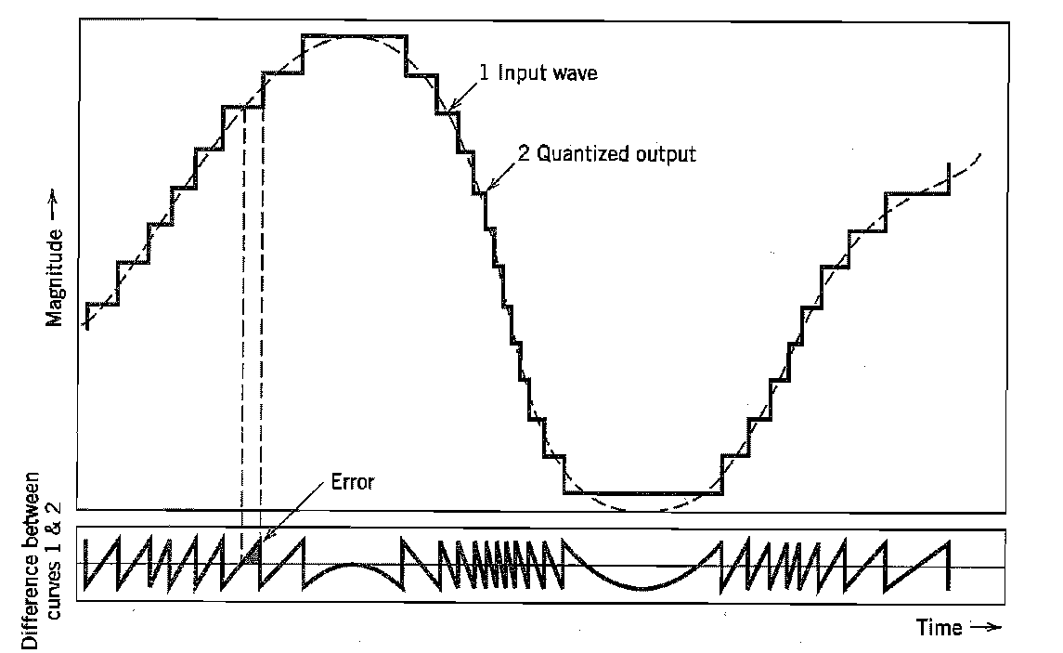
Quantization Noise
Error between input signal m and output signal v.

Slide 5
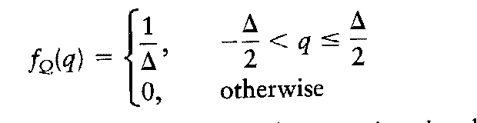
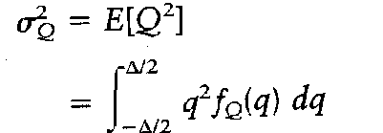
Quantization Noise
Consider m in range (-m_{max},m_{max}). Consider uniform quantizer of midrise type. The step size Δ is given as
The quantizer Q is bounded by
Q is uniformly distributed with pdf as below.
Variance

Slide 6
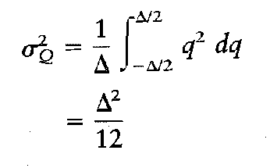
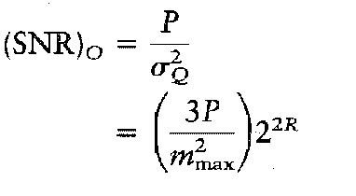

Quantization Noise
L levels in binary form L=2^{R} where R is no.of bits/sample.
or R=log₂L, Thus
Where P is average power of m(t)

Slide 7


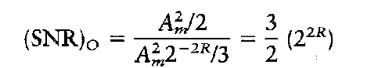

Quantization noise for sinusiodal signal
Average power across 1 ohm load is given as
Variance of quantization noise is given as
Thus, output SNR is given by
In deccibel’s
It shows that addition of every single bit improves SNR by 6dB.

Slide 8
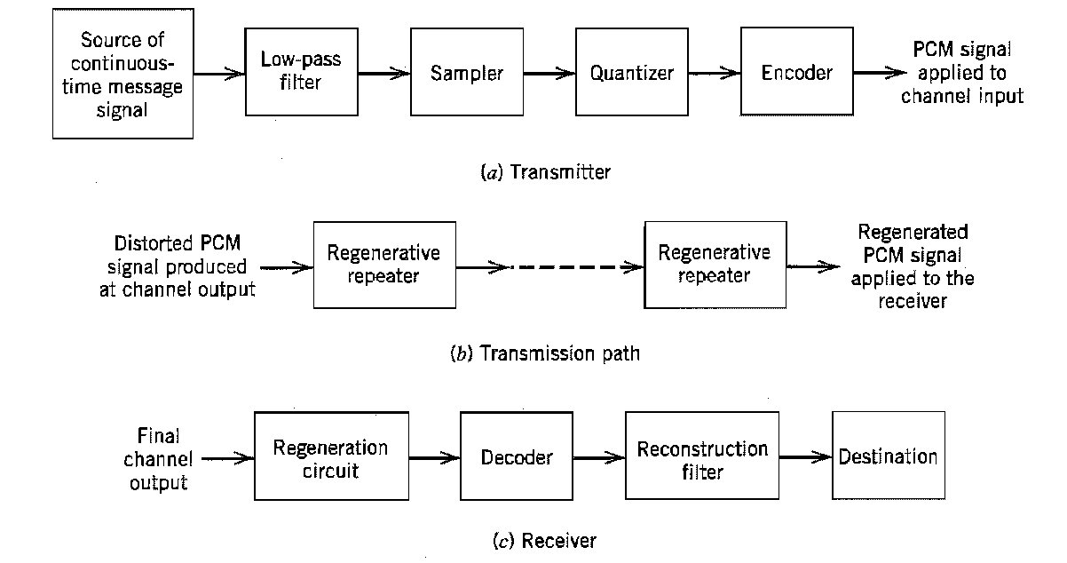
PCM

Slide 9
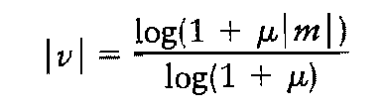
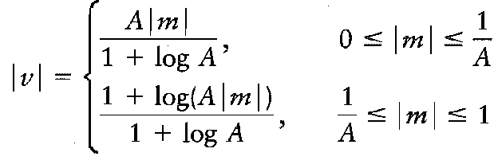
Non Uniform Quantizer
It is used to reduce quantization error.
Combination of compressor and expander is called companding.
μ-law
It is linear at low input level and logarithmic at high input levels.
A -law

Slide 10
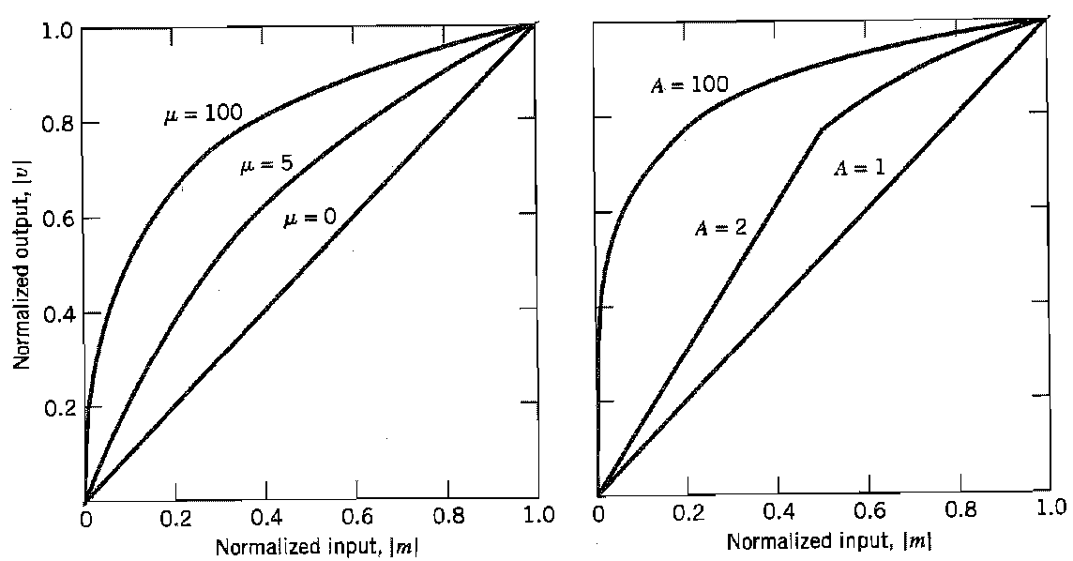
Μ-law and A-law

Slide 11
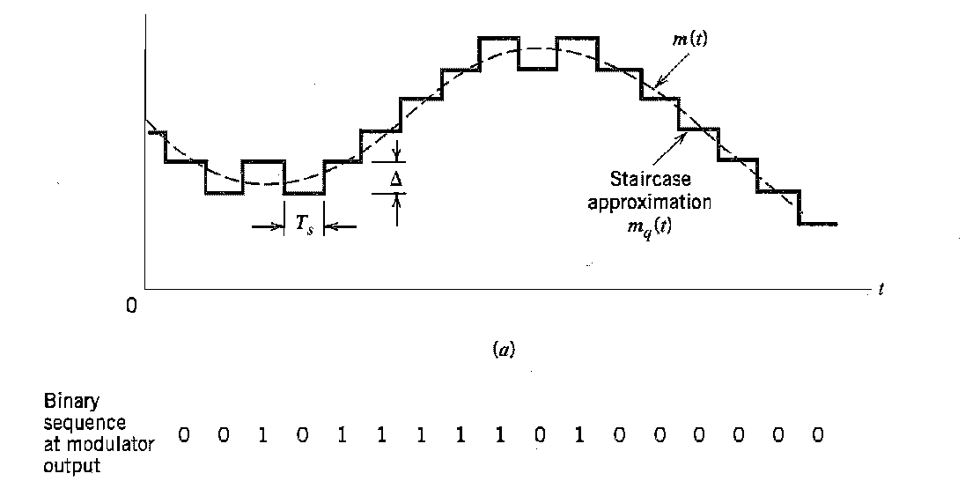
Delta Modulation
Messages are oversampled to get correlation between adjacent samples.
Two quantization levels ±Δ.

Slide 12
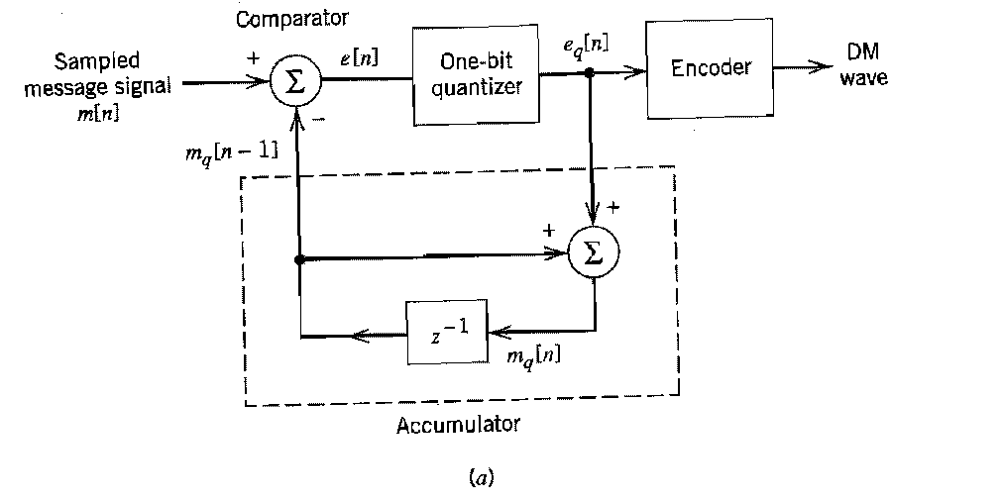
Delta Modulation
e[n] = m[n] - m_{q}[n-1]
e_{q}=Δsgn[e(n)]
m_{q}[n]=m_{q}[n-1]+e_{q}[n]

Slide 13
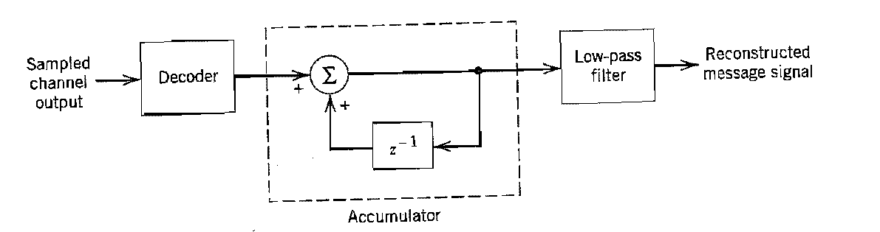
Delta Demodulation

Slide 14
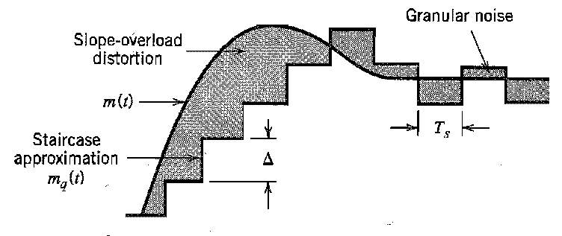
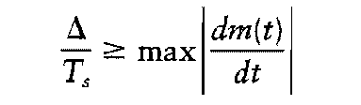
Noise in DM
e[n]= m[n] - m[n-1] - q[n-1]

Slide 15
ADM
If successive errors are of opposite polarity, it means DM is operated in granular region, it’s better to reduce step size.
If successive errors are of same polarity, it means DM is operated in slope overload region, it’s better to increase step size.
Step size is increased or decreased by 50% at each iteration.

Slide 16
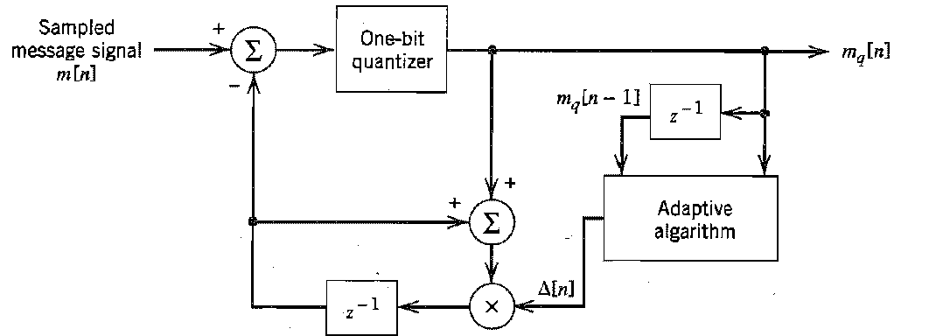
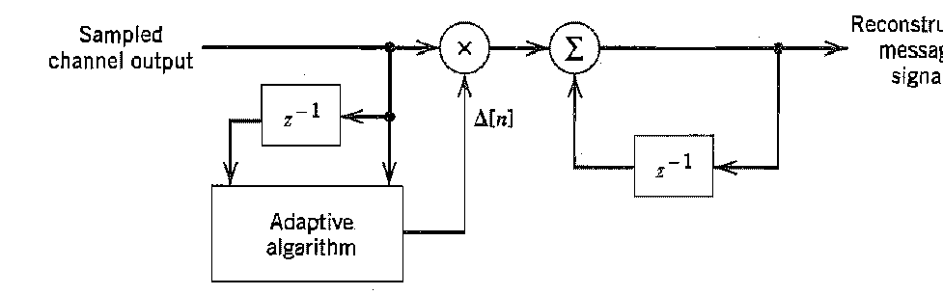
ADM

Slide 17
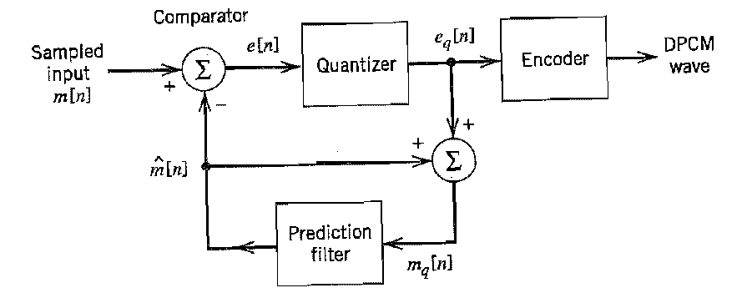
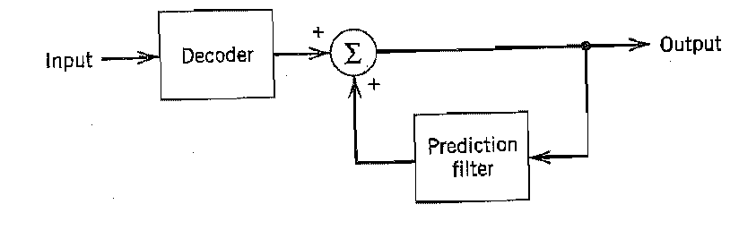
DPCM

